Slide 1
ECE298 Reservoir System Design Review

Slide 2
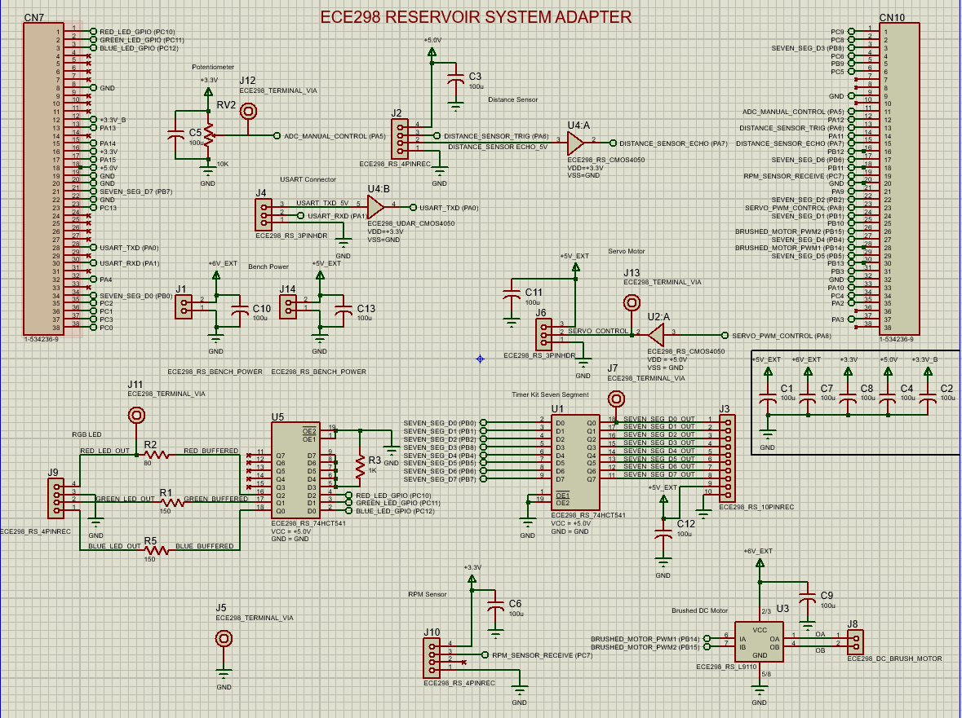
Overview
Notes:
The reservoir system is powered by the 3.3V and 5V pins from the STM32, as well as 5V and 6V bench powers for the motors. All sensors and motors are controlled and utilized via the GPIO pins on the microcontroller. This design contains manual and terminal control for interfacing with the system, as well a display and RGB LED for visual aid. The pump for pumping water in and out of the reservoir is controlled by a brushed DC motor, and the distributer for distributing water to each of its 3 pipes is controlled with a servo. Lastly, the reservoir water level is monitored by an ultrasonic distance sensor.

Slide 3
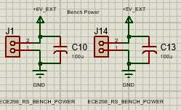
Bench Power
Operating Voltages: 5V and 6V external
Capacitors: 100 µF
Notes:
There’s two connectors for external power here—6V and 5V—each with a ground. We added a capacitor across each supply to filter out noise and fluctuations from the bench power supply, ensuring steady voltage for the components. This setup helps prevent voltage drops or spikes, delivering stable power to maintain performance and protecting sensitive components.

Slide 4
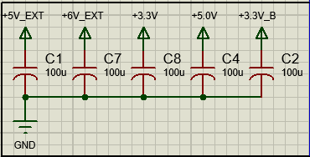
Power Decoupling
Operating Voltages : 3.3V, 5V, and 6V
Capacitors: 100 µF
Notes:
The power decoupling uses 100 µF capacitors between ground and various voltage rails to stabilize power by filtering high-frequency noise and spikes. With different components drawing power at different times, these capacitors smooth fluctuations on each rail (5V, 6V, 3.3V). Placing them close to each rail provides localized filtering, minimizing interference or dips that could affect sensitive components.

Slide 5
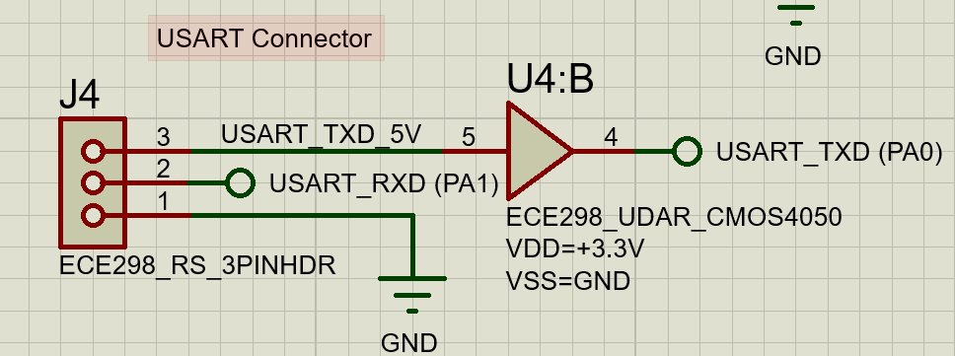
USART Connection
GPIO Pins: A0 (output), A1 (input)
Operating Voltage: 3.3V
Notes:
Firstly we have the USART connnection. This allows the operator to interface
with the resevoir system via a terminal computer. This requires 2 lines: a transfer
line (TXD) and a receiving line (RXD). Since the STM32 only accepts a 3.3V input signal on
its GPIO pins, a buffer is used to translate the 5V high signal from the terminal to a 3.3V
signal on the transfer line. The USART connection can tolerate the 3.3V high signal from the MCU, so no buffer
is required on the receiving line

Slide 6
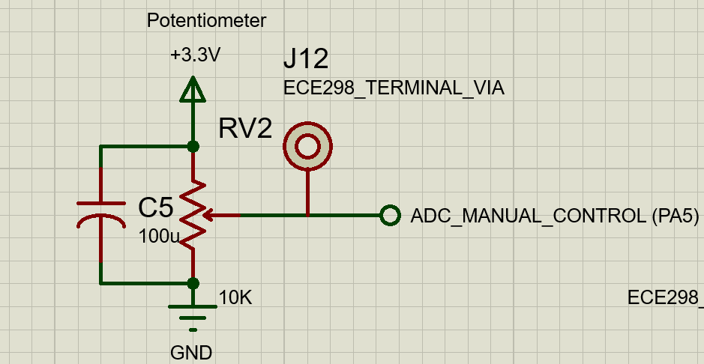
Manual Control
Output Voltage Range: 0V to 3.3V
Output Pin: A5 (ADC pin)
Notes:
The potentiometer is used for manual control of the reservoir signal. A decoupled 3.3V source is applied across a variable potentiometer, which results in a variable output voltage in between 0 and 3.3V. Pin A5 is then used for its ADC capabilities to translate this voltage into an 8-bit number for use by the microcontroller. The test point can be used to ensure the correct range and values for this variable output voltage.

Slide 7
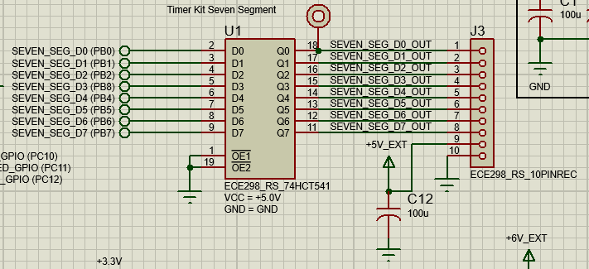
Seven Segment Display Connection
Timer Kit Operating Voltage: +5V
GPIO Output Pins: B0, B1, B2, B8, B4, B5, B6, B7
Notes:
Next, the Timer Kit from Lab A is used for its seven-segment display. As the seven segment display requires a 5V high signal to operate, a buffer is used to translate the 3.3V signals from the MCU’s gpio pins to 5V signals. The connector to interface with the board contains 7 pins for each of the 7 segments, a 5V external pin for powering the board and a ground pin. Additionally, the test point allows the user to ensure the correct signal is reaching the timer board at all times

Slide 8
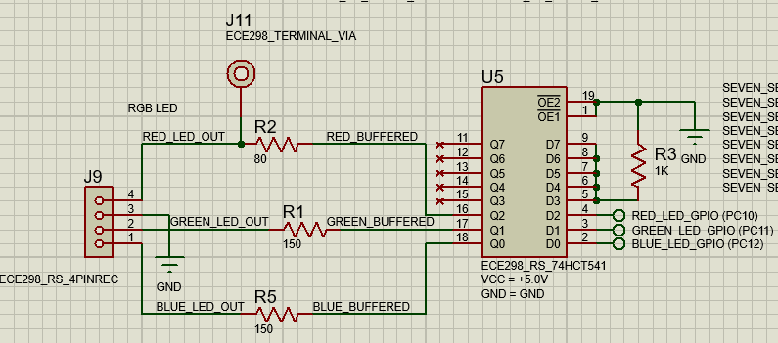
RGB LED
Operating Voltage: +5V
GPIO Output Pins: C10, C11, C12
Notes:
This circuit controls an RGB LED using GPIO pins through a 74HCT541 buffer, with each LED color regulated by its own resistor (R2, R1, R5) to manage current and brightness. The buffer isolates and boosts the GPIO signals (PC10, PC11, PC12) to handle the LED’s current needs, protecting the microcontroller. Each LED is connected to a separate GPIO pin for smooth color mixing, with the buffer and LEDs powered by 5V for stable operation.

Slide 9
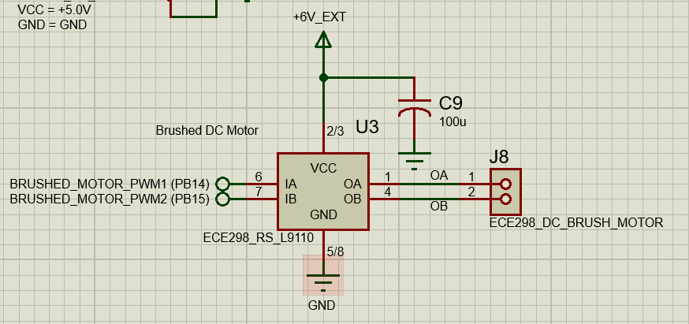
Brushed DC Motor
Operating Voltage: 6V external
GPIO Output Pins: B14, B15 (PWM pins)
Notes:
This circuit controls a brushed DC motor using a motor driver powered by an external 6V supply, providing sufficient voltage without burdening the STM microcontroller. A capacitor smooths out voltage spikes, ensuring steady motor performance under load. The microcontroller’s PWM signals connect to the driver inputs, adjusting motor speed via duty cycle changes and reversing direction by toggling the inputs. The driver outputs connect to the motor terminals.

Slide 10
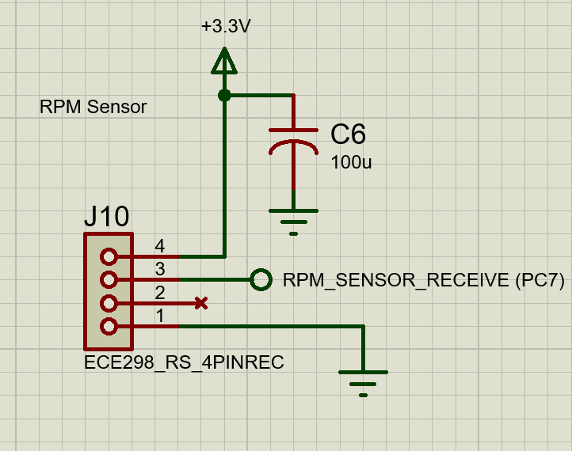
RPM Sensor
Operating Voltage: +3.3V
GPIO Input Pin: C7 (Receive pin)
Notes:
This circuit reads RPM data from a sensor, with a stable 3.3V supply for accuracy. This 4-pin header contains a power, ground, and signal, with a 100 µF capacitor (C6) smoothing any voltage fluctuations. The sensor’s output is routed to the "RPM_SENSOR_RECEIVE" pin (PC7) for clean, reliable RPM data.

Slide 11
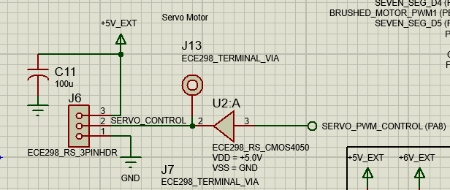
Servo Control
Operating Voltage: 5V external
GPIO Input Pin: A8 (PWM pin)
Notes:
Moving on we have the servo that controls which pipe the reservoir is connected to. The servo is powered by the decoupled external 5V bench power to reduce noise. Pin A8 on the STM32 supports PWM outputs, so its 3.3V high signal is translated to a 5V high signal for PWM motor control. The additional test point can be used to monitor this translated PWM signal. The connector allows for wire connections to this translated PWM signal, the external bench power, and ground.

Slide 12
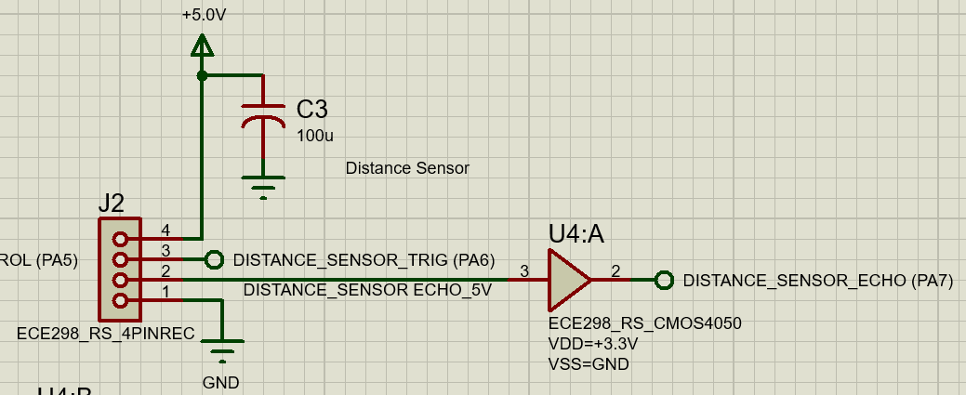
Distance Sensor
Operating Voltage: +5V
GPIO Pins: A6 (output), A7 (input)
Notes:
Lets continue with the HCSR04 distance sensor, which monitors the water level of the reservoir. The sensor has a trigger signal for starting the collection of data, and an echo signal for the transfer of this data. A buffer is used to translate the 5V echo signal of the sensor to a 3.3V signal that complies with the STM32’s gpio pins. Since the sensor can tolerate the 3.3V high signal from the MCU, no buffer is needed. A 4 pin connector connects the decoupled 5V supply voltage, trigger, echo, and ground reference signals to the sensor.

